Slide 1

All you need to know…

Slide 2
Objectives
The Medical Training Survey gathers feedback from doctors in training in Australia to:
Understand
Better understand the quality of medical training in Australia
1
Identify and improve
Identify how best to improve medical training in Australia
2
Recognise and respond
Recognise and deal with potential issues in medical training that could impact on doctor in training and patient safety, including environment and culture, unacceptable behaviours and poor supervision.
3
Notes:
The Medical Training Survey has been running since 2019 and is run each year to get feedback from doctors in training in Australia to:
better understand the quality of medical training in Australia
identify how best to improve medical training in Australia, and
recognise and deal with potential issues in medical training that could impact on patient safety, including environment and culture, unacceptable behaviours and poor supervision.

Slide 3
Stakeholders
Working together on the Medical Training Survey
Postgraduate Medical Councils
Medical Deans of Australia and NZ
Ahpra
Employers
Doctors in training
Doctors’ Health Services
Medical Council of New South Wales
Medical Board of Australia
Specialist colleges
Australian Medical Council
Health departments
Educators
Australian Medical Association
Australian Indigenous Doctors’ Association
Notes:
MTS was the idea of doctors in training, educators and employers.
It is a joint effort from doctors in training, specialist colleges, employers, health departments, educators, the AMA, Doctors’ Health Services, Postgraduate Medical Councils, Australian Indigenous Doctors’ Association, the AMC , the Medical Council of NSW, the Medical Board and Ahpra.
The Medical Board of Australia and Ahpra are making it happen.
A Steering Committee and a Consultative Forum advise the Board on the survey.
The Consultative Forum includes representatives from doctors in training, jurisdictions, Australian Medical Association, Australian Medical Council, Australian Indigenous Doctors’ Association, Doctors Health Services, Directors of Clinical Training, Postgraduate Medical Councils, Medical Deans of Australia and New Zealand and the Medical Board

Slide 4
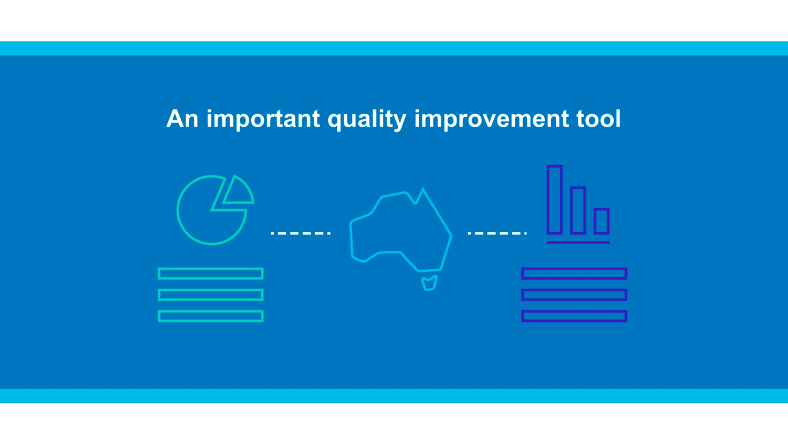
Why it’s important to do the MTS!
Notes:
Your feedback helps!
It is safe and confidential to do the MTS. Survey data is de-identified in reporting of results. Only de-identified data is shared with the Board and Ahpra.
The MTS encourages trainees to reflect on their medical training and teaching and provide feedback to support continuous improvement.
Reflective practice is a cornerstone of good medical practice and of the Professional Performance Framework.
MTS data is a valuable quality improvement tool for stakeholders who are developing and delivering medical training.
Visit MedicalTrainingSurvey.gov.au to read how stakeholders are using the results to drive positive change in medical training in Australia.

Slide 5
What’s in the MTS ?
Demographic
Training post
Events
workplace environment and culture, access to teaching, clinical supervision and wellbeing
Training program
curriculum, assessment, engagement with trainees
Overall satisfaction
Patient safety
Future career intentions
About you
Notes:
Routine survey questions fall into six broad topics and ask for doctor in training feedback on the following issues:
Demographic
Training program curriculum
Training program assessment
College engagement with trainees
Workplace environment and culture
Access to teaching
Clinical supervision
Training post orientation
Wellbeing
Patient safety
Overall satisfaction
Future career intentions
About you
Survey questions are tailored to the needs of each group of doctors in training.

Slide 6





Five groups of doctors in training
= five survey versions
Interns
Prevocational & unaccredited trainees
Specialist
trainees
(non-GP)
Specialist
GP trainees
IMGs
Notes:
There are 5 versions of the MTS, one each for.
Interns
Prevocational and unaccredited trainees
Specialist trainees (non-GP)
Specialist GP trainees
IMGs
Most questions are common across all surveys, the rest are tailored to each group of doctors in training
The MTS builds on doctor in training surveys conducted by jurisdictions and colleges
The MTS generates national, cross profession data being used to improve medical training.

Slide 7

How to do the survey
Prevocational & unaccredited trainees
Specialist trainees (non-GP)
Specialist GP trainees
Renewal of registration
Notes:
Doctors in training do the survey when they renew their medical registration in August – September:
First register
Then do the Workforce Survey
Then do the Medical Training Survey.

Slide 8
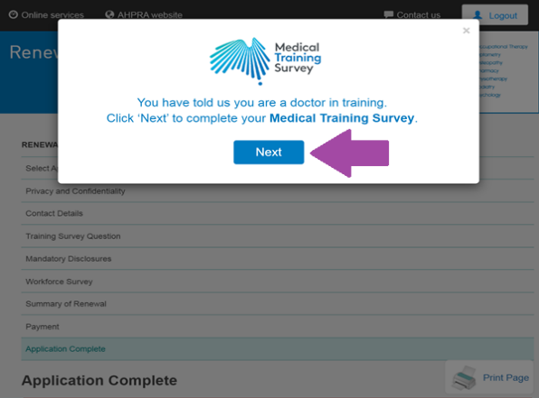

Where is my survey link?
Notes:
When you renew your registration, your survey link will appear at the end of registration process. A pop-up box will appear. Simply click ‘next’ to start your Medical Training Survey!
If you miss the pop-up box, you can find your link in a red box in your confirmation of registration webpage. If you miss it, Ahpra will send it to you in the email confirming your registration.

Slide 9

How to do the survey
Interns
IMGs
Email from the Medical Board of Australia with a unique survey link
Notes:
For Interns and IMGs, you will receive an email invitation from the Medical Board of Australia to participate in the MTS. This email will contain a unique survey link

Slide 10





How are the results used?
Advocate
Workplace culture
Accreditation
Workforce strategy
Health & wellbeing
Notes:
Stakeholders are using the results more and more to identify areas for improvement and drive positive change in the medical training space.
Some examples include:
Advocacy: The Australian Medical Association using the results to provides a comparison of the training experience between different specialty training pathways and identifies areas of excellent experience as well as areas for improvement.
Accreditation: Australian Medical Council are using it for accreditation assessments and monitoring activities.
Health and wellbeing: QLD Health are using the data to support their work on mental health and wellbeing for QLD doctors.
Workforce strategy: Council of Presidents of Medical Collects is using the data to shape workforce policy
Workplace culture: Royal Australasian College of Physicians stated that the MTS data was used to drive the Safe Training Environments Summit. Education and trainee leaders and invited guests agreed on a strategic approach to tackling bullying, harassment, and discrimination in physician training environments.

Slide 11
MedicalTrainingSurvey.gov.au
Notes:
There is a dedicated MTS website, with loads of information about the survey, including results from 2019 to 2023.
All you need to know about the Survey is published on the website!
This includes:
Results from the 2019, 2020, 2021, 2022 and 2023 surveys
Interactive dashboard where you can create your own tailored reports – with options to output in Excel or PDF
Communications toolkit
Survey questions

Slide 12

Opens August 2024
For more information visit: www.MedicalTrainingSurvey.gov.au

